Slide 1
AIML CA1 Classification ST1511
Chiam Joon Wee
P2222415
DAAA/FT/2A/05

Slide 2
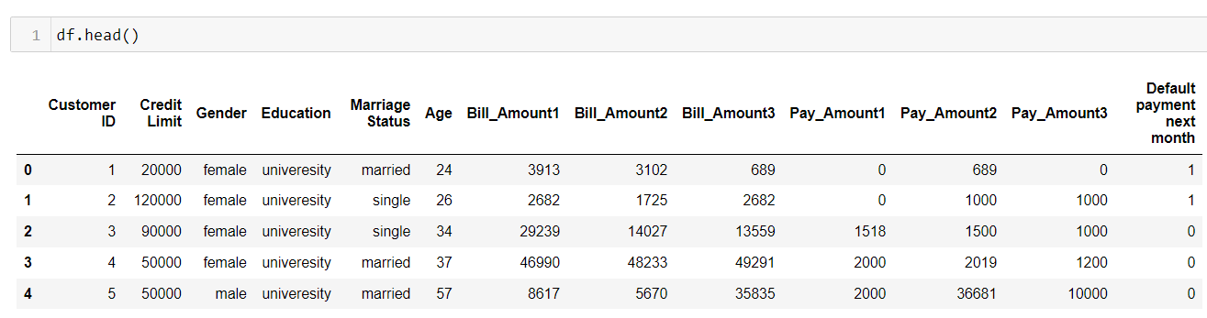
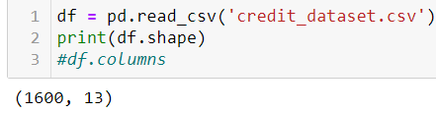
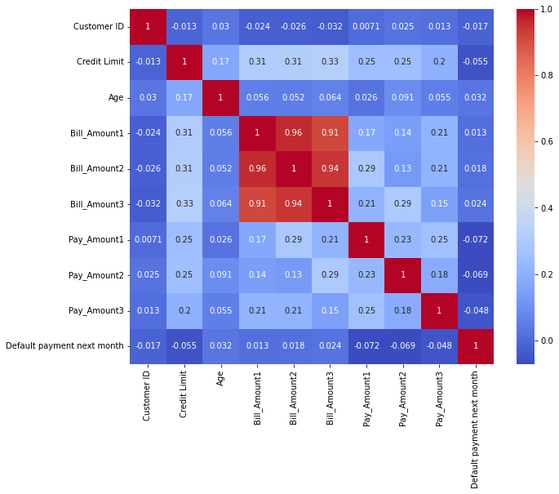
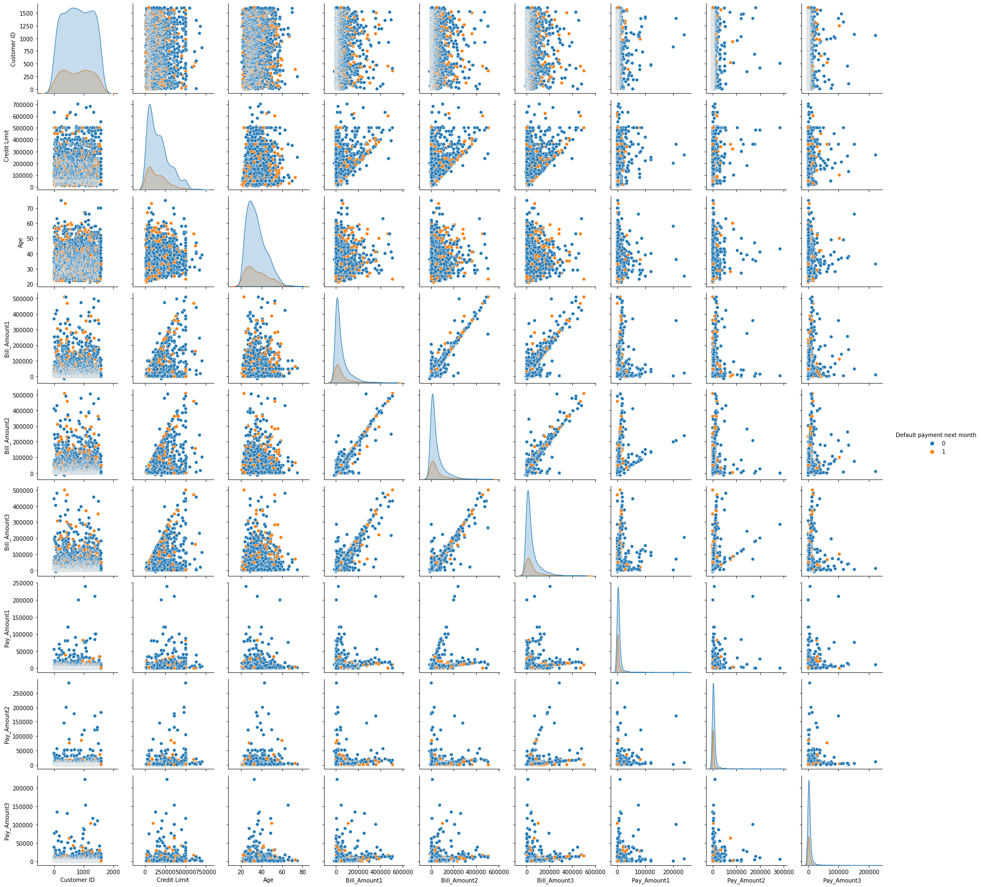
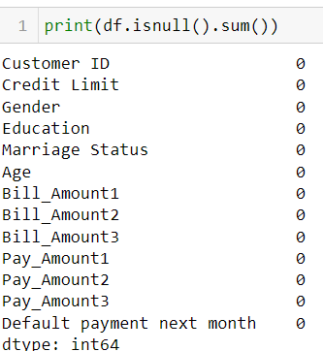
Background research & data exploration

Slide 3
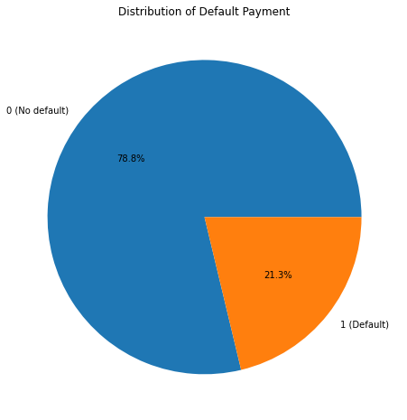
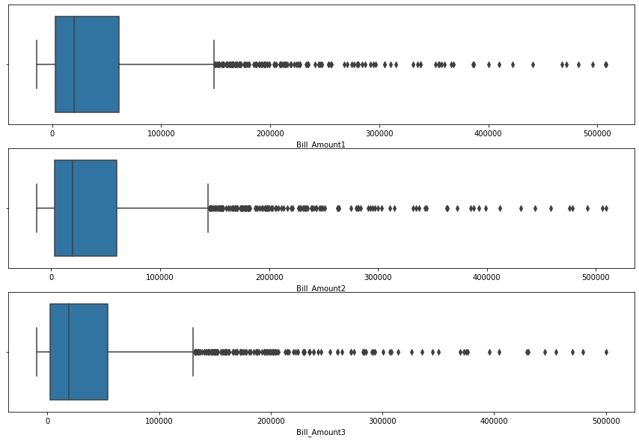
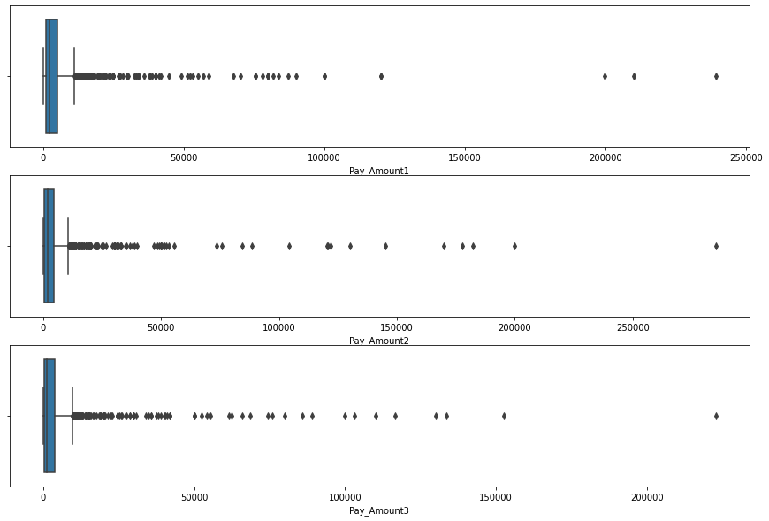
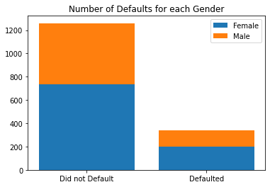
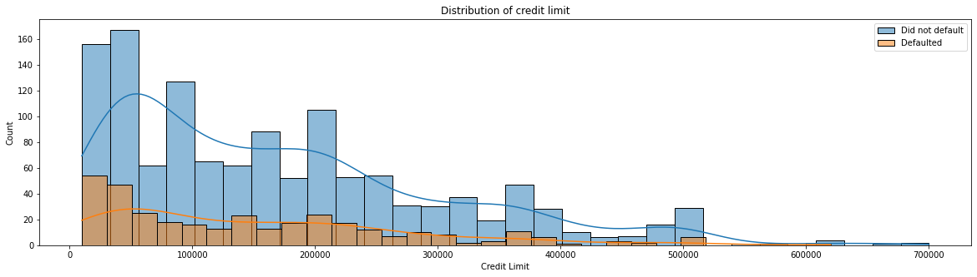
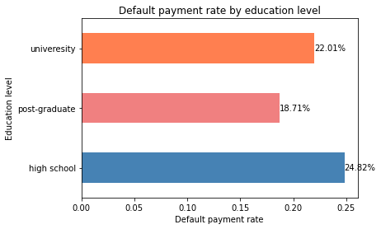
Background research & data exploration

Slide 4
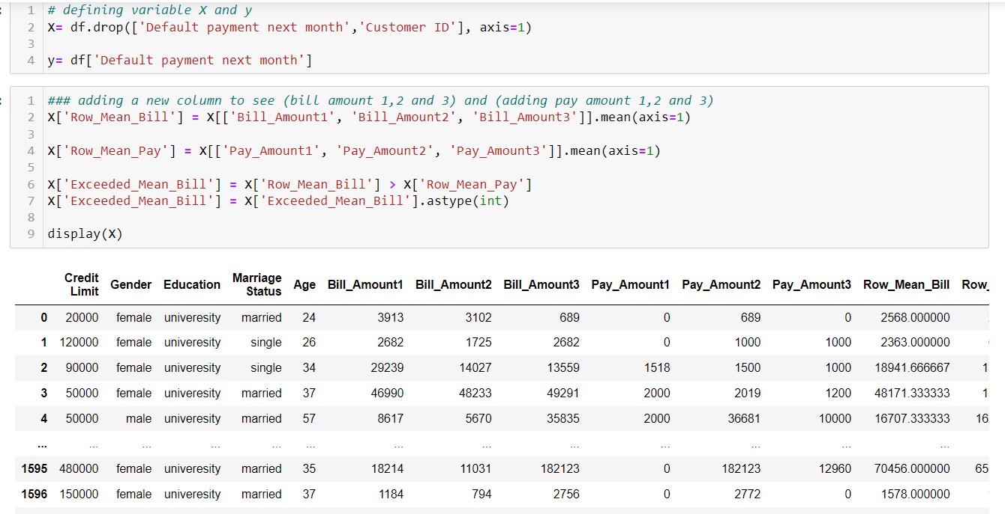
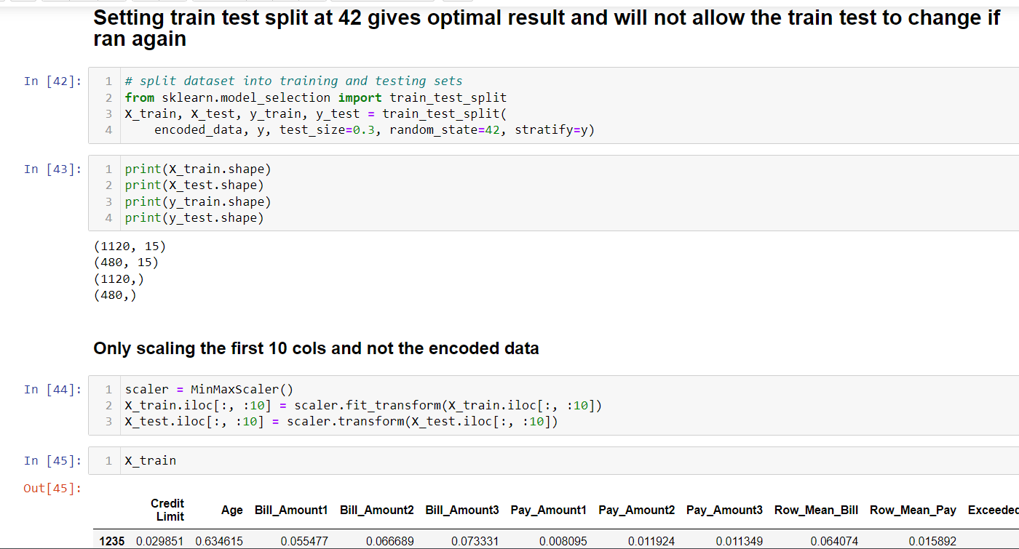
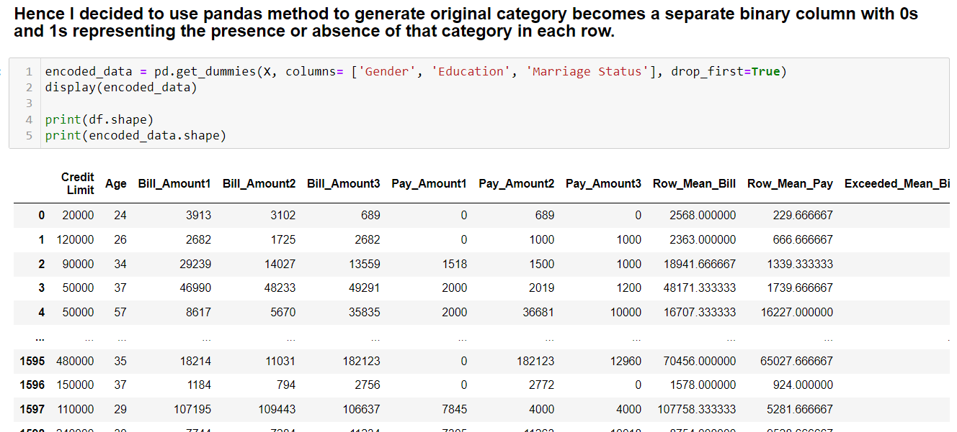
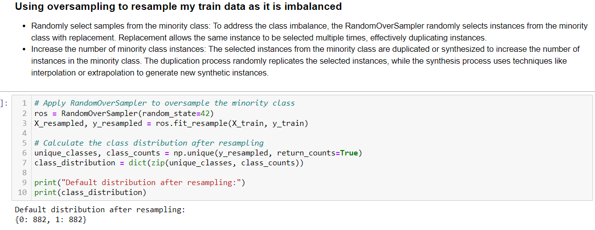
Data engineering/ data processing

Slide 5
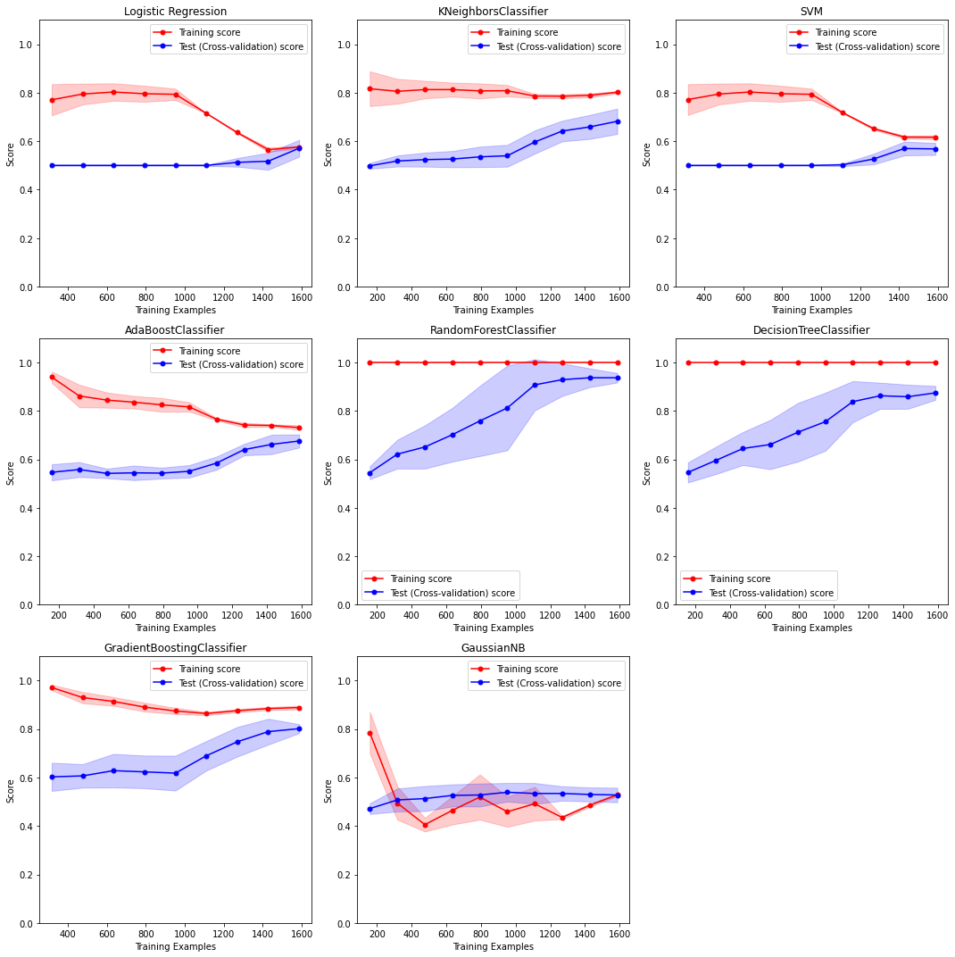
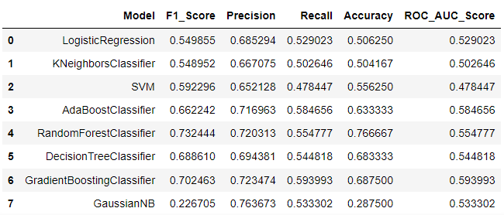
Modelling and evaluation
How do I plan to evaluate my system.
- Objective:
Build a classification model to predict which customer will have default payment in the next month.
- Plan:
Want to have true positives, to actually know if the customer defaults
Want to have true negatives as well, to know that the customer didn’t actually default.
-Conclusion:
Therefore, I chose to look at F1 score

Slide 6
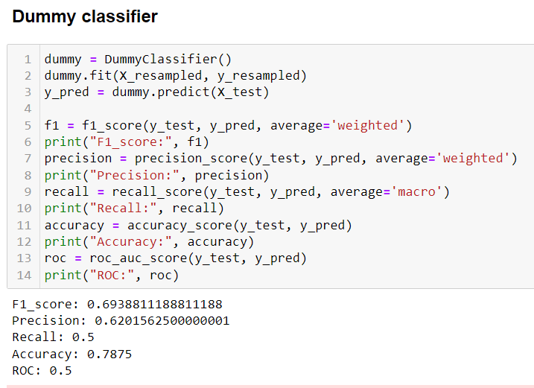
Comparison to a dummy classifier as a baseline
My models chosen for hyper param tuning are
Random Forest
Gradient Boosting
They have higher F1 score and roc score compared to the dummy

Slide 7
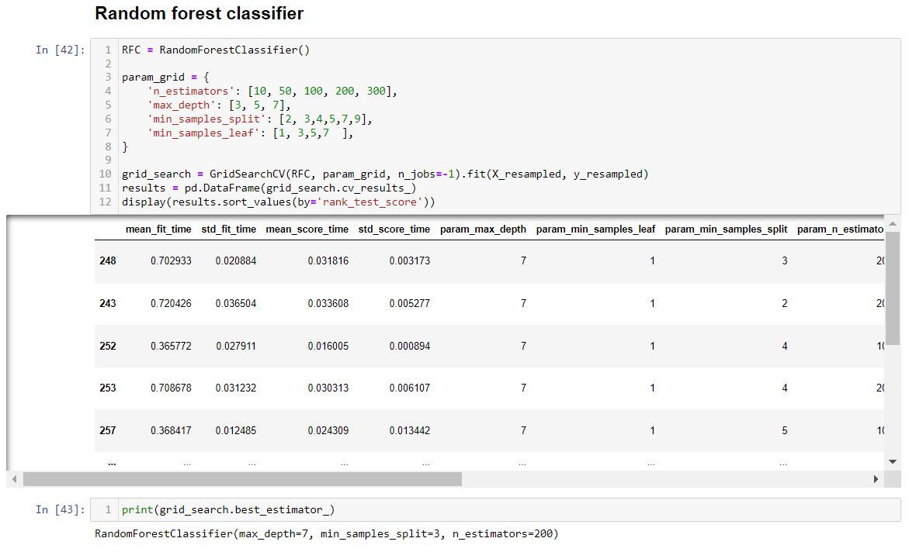
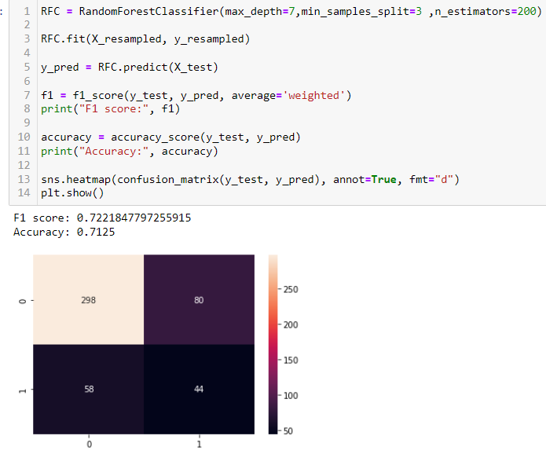
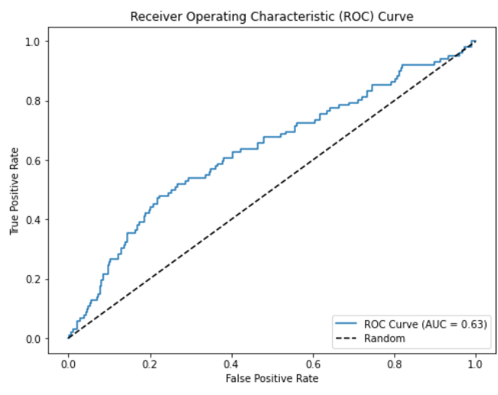
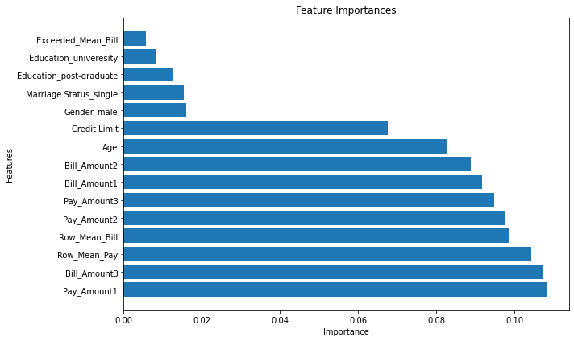
Model improvement

Slide 8
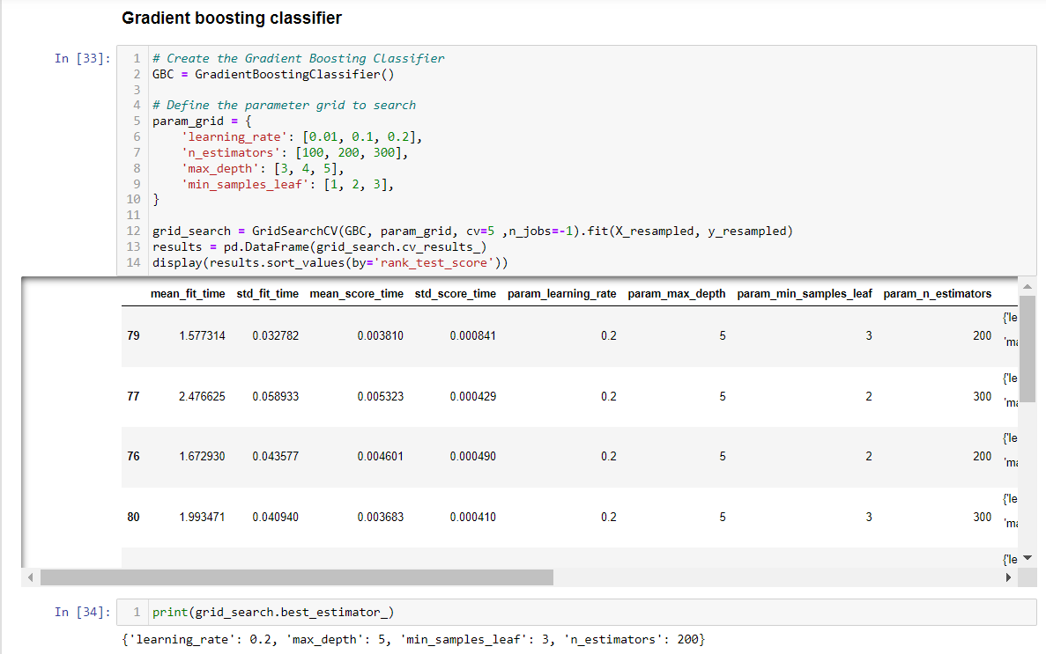
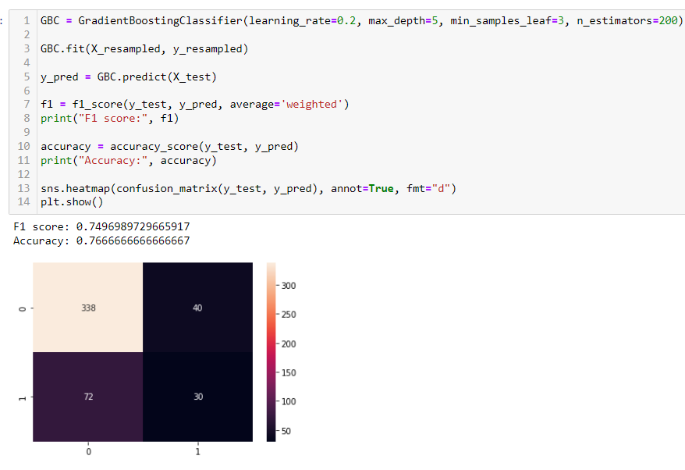
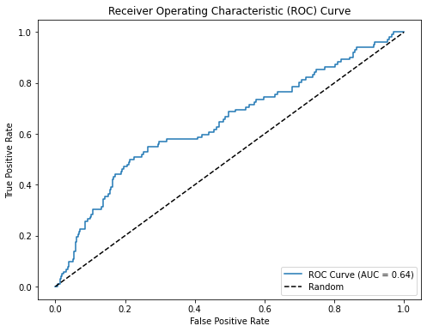
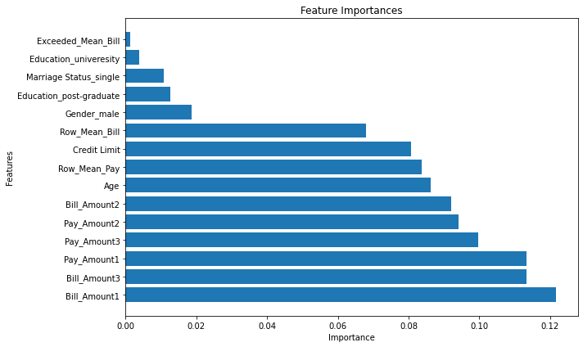
Model improvement

Slide 9
Evaluation (which model is the best)
Random Forest
- 58 type 1 error, 80 type 2 error
- F1 score = 0.722, ROC score 0.63
Gradient Boosting
- 72 type 1 error, 40 type 2 error
- F1 score = 0.749, ROC score 0.64
Conclusion:
My Gradient boosting model is the best model out of the other models as it has:
- Highest F1 score
- Lower type 1 and 2 errors
- Higher ROC score

